Slide 1
Warm-core vs. cool-core vortices Combining the prior concepts of: thermal wind and vorticity Background first, then Assignment: slides 22-38
ATM 561, fall 2019
Brian Mapes, Univ of Miami

Slide 2
The big idea of it
In the thermal wind lab, you learned about how the slope of pressure surfaces (indicating the PGF) balances the Coriolis force in geostrophic flow
You also learned how thickness (between pressure surfaces) is proportional to T
This gave you a 3D view of T around wind jets.
But wind always blows in circuits (circulations), so it is often more useful to think of vortices (with vorticity as the budget equation) as the fundament of flow.
Then T is understood in terms of warm and cool cores.

Slide 3
p surfaces on a z-coordinate diagram
for NH westerly jet stream in thermal wind balance
→
z
150 mb
thinner mass (Δp) layers,
cooler compared to
← that
big thickness of mass (Δp)
layers: warm compared to that →
200 mb
300 mb
Jet stream
into page
PGF is “downhill”
Coriolis force to R
500 mb
small thickness of
mass (Δp) layers:
cooler, compared to that→
same mass (Δp) layers
are thicker: warmer than
← that
700 mb
1000 mb
North
South

Slide 4
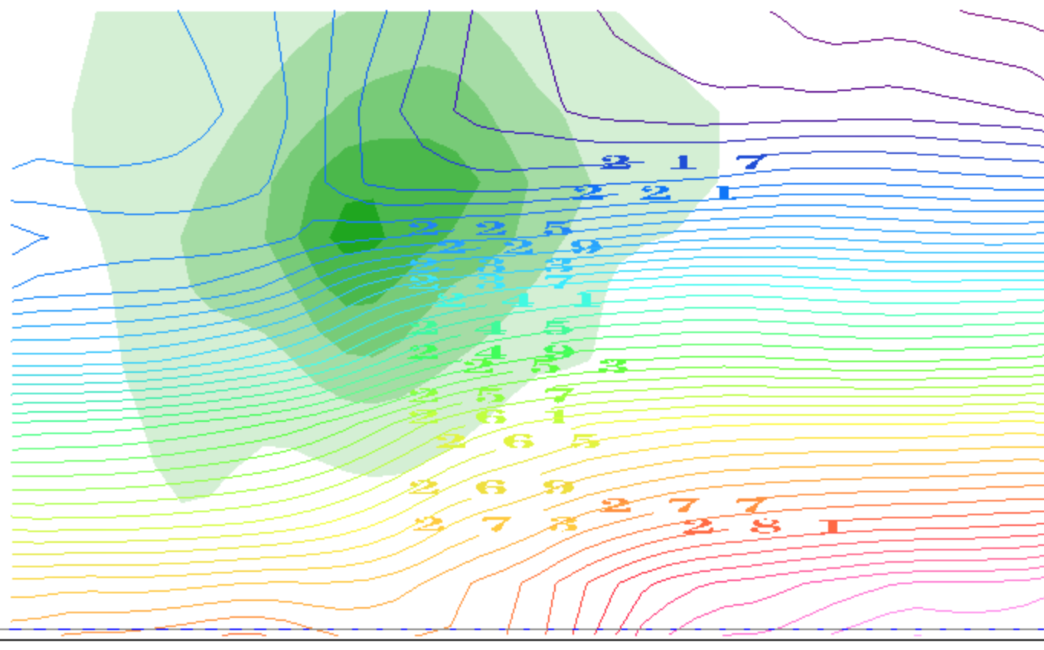
contours of T(K): it decreases with height
(plus the horizontal gradients due to TWB)
thinner mass (Δp) layers,
cooler compared to
← that
big thickness of mass (Δp)
layers: warm compared to that →
small thickness of
mass (Δp) layers:
cooler, compared to that→
same mass (Δp) layers
are thicker: warmer than
← that
North
South

Slide 5
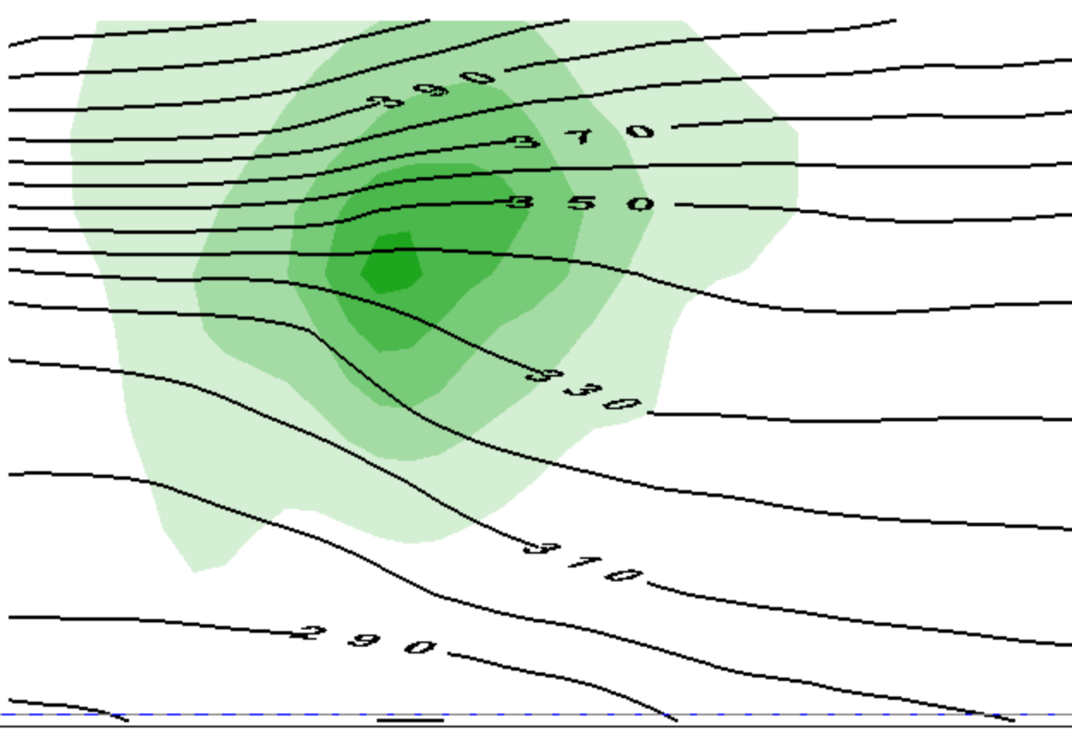
contours of θ(Κ): it increases with height
(plus the horizontal gradients due to TWB)
thinner mass (Δp) layers,
cooler compared to
← that
big thickness of mass (Δp)
layers: warm compared to that →
small thickness of
mass (Δp) layers:
cooler, compared to that→
same mass (Δp) layers
are thicker: warmer than
← that
North
South

Slide 6
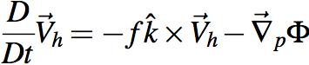
That view emphasized jet streams as the unit of flow
OK, suppose we want to think in those terms.
What is a jet made of?
momentum, or ½ its square KE
per unit mass
What equation governs momentum?

Slide 7
That view emphasized jet streams as the unit of flow
To predict vector momentum V_{h}, need Φ
But that drags thermo into our equation set
must predict T, not just guess its structure by TWB
We work hard to avoid that with vorticity

Slide 8
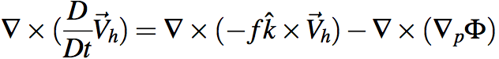
Holy grail of dynamics: get div & ω
Gotta avoid dragging thermo into this via Φ.
Get rid of Φ at any cost. Curl to the rescue!
Ker-CHING!
We are Masters of the Universe with our sexy vector identities!
The grail is in the bag!
Notes:
\nabla \times (\frac{D}{Dt} \vec V_h) = \nabla \times (-f \hat k \times \vec V_h) - \nabla \times (\nabla_p \Phi)

Slide 9
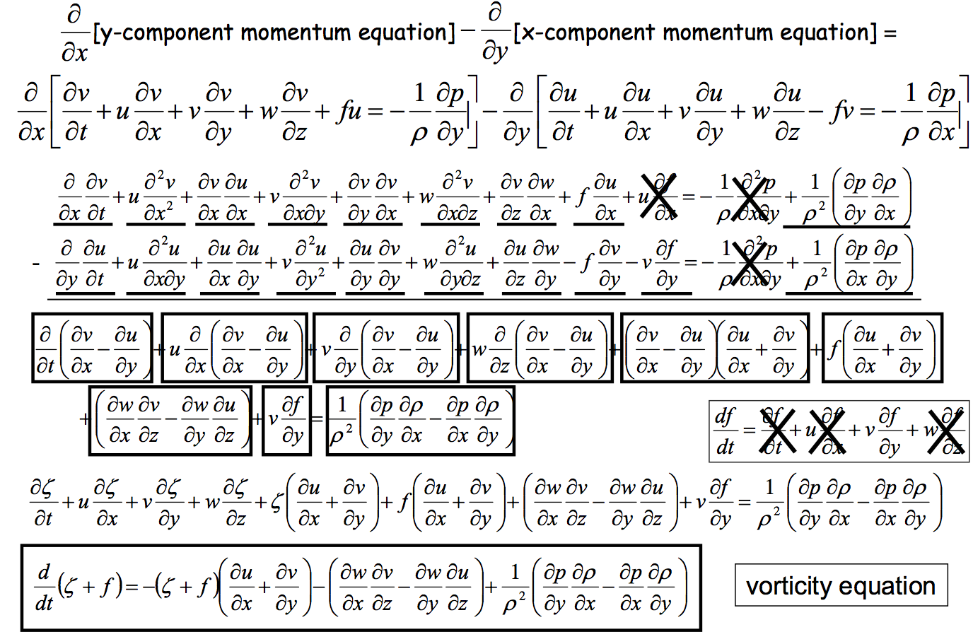
Heh heh ... did I say "any cost"... ? gulp
Can we scrape back some of these cobwebs?
Wait a sec, what's this??

Slide 10
This view emphasizes vortices as the unit of flow
To predict vorticity, we just need vorticity
induced wind drops like 1/distance
vorticity itself is advected by wind like a tracer
plus complications
advection of planetary vorticity f →Rossby waves
divergence term can be rolled up into potential vorticity

Slide 11
So what’s the TWB structure of a vortex?
In this case, one near the tropopause (like the jet stream)

Slide 12
This is only half the story of a vortex
cooler than
← that
warmer than
that →
cooler than
that→
warmer than
← that

Slide 13
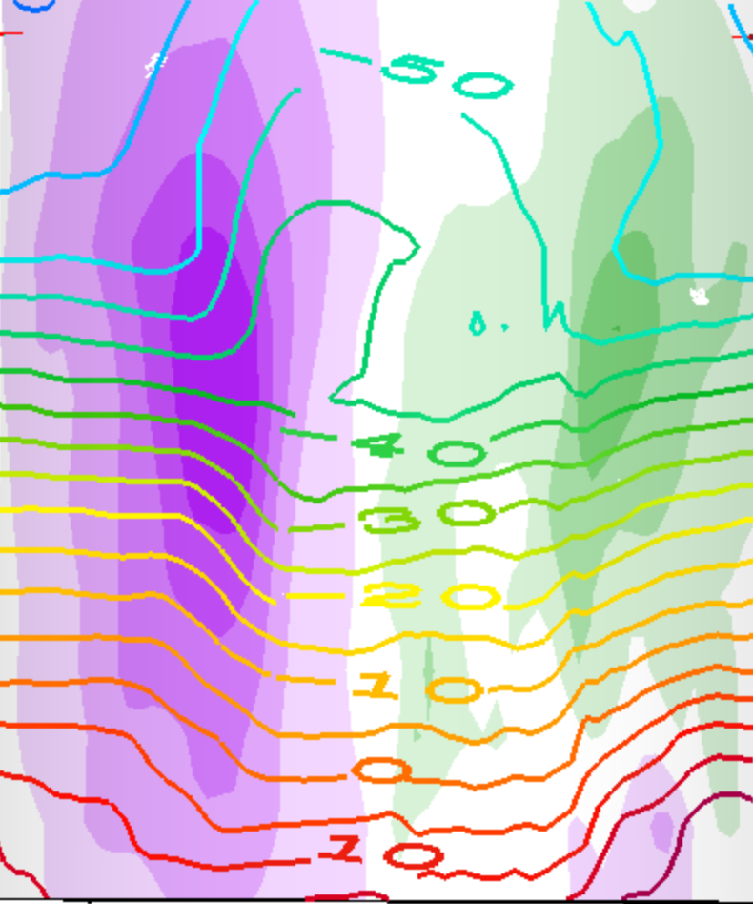
This is a whole vortex (two jets)
T(K) contours
cooler than
that →
warmer than
← that
cooler than
← that
warmer than
that →
warmer than
that →
cooler than
← that
cooler than
that→
warmer than
← that

Slide 14
This is a whole vortex (two jets)
T(K) contours
warmer than
← that →
above the core
cooler than
← that →
below the core

Slide 15
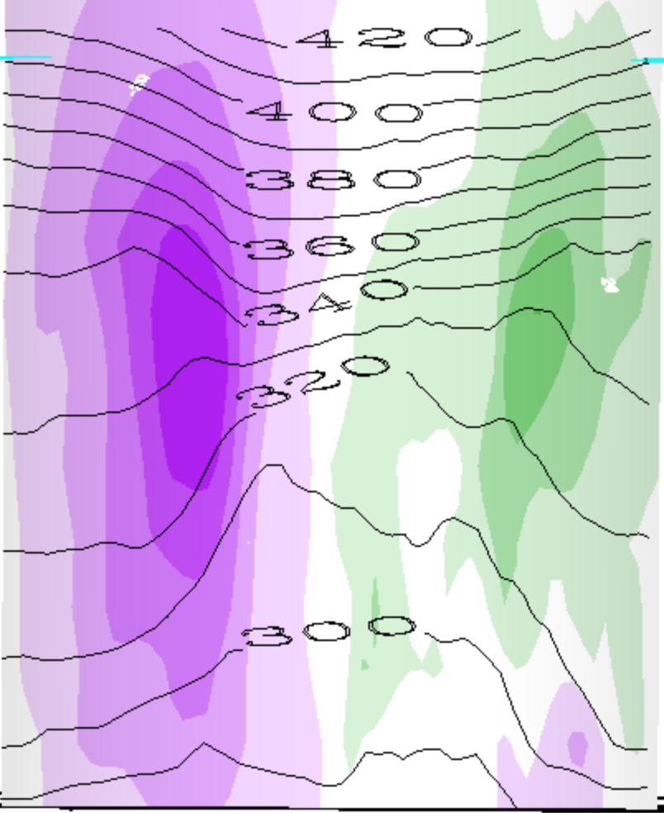
This is a whole vortex (two jets)
θ(K) contours
warmer than
← that →
above the cyclone
cooler than
← that →
below the cyclone

Slide 16
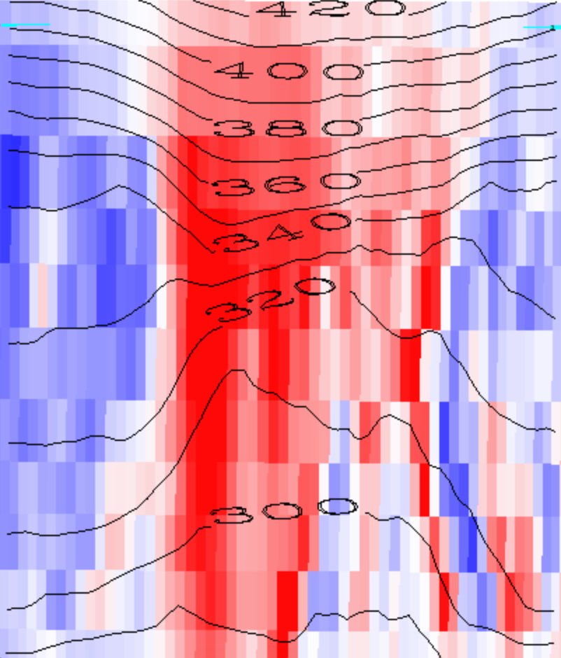
Red is positive vorticity , θ(K) contours
warmer than
← that →
above the cyclone
cooler than
← that →
below the cyclone

Slide 17
Red is positive vorticity , θ(K) contours
warmer than
← that →
above the cyclone
Cyclonic Vortex
cooler than
← that →
below the cyclone

Slide 18
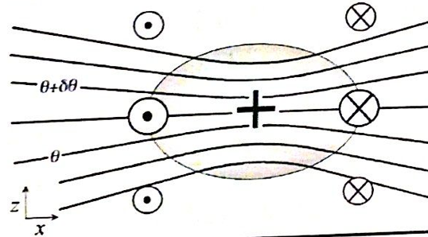
Generalization: PV
1. We will see that every cyclonic vortex obeying vertical (hydrostatic) and horizontal (geostrophic or other) balance looks similar to this (maybe stretched or shrunk):
PV > 0

Slide 19
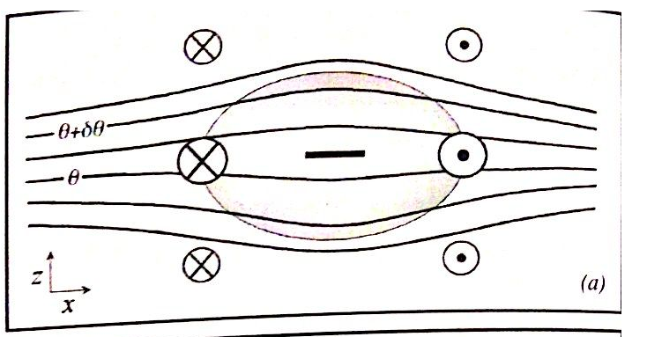
Balanced anticyclones exist too...
Just the opposite of a cyclone...
PV < 0

Slide 20
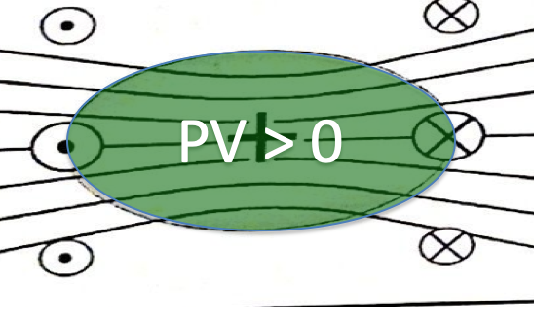
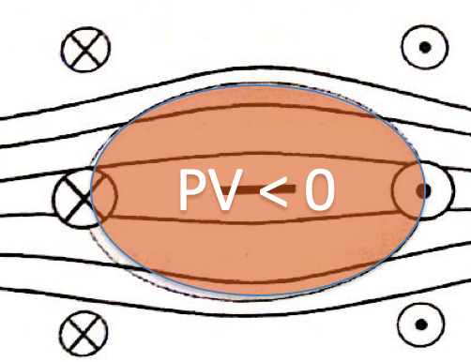
Vorticity (or PV) blobs
Where do they come from?
How do they interact?
(this we studied, in the horizontal plane)
Do they get destroyed?
(Soon: tackling the complications)

Slide 21
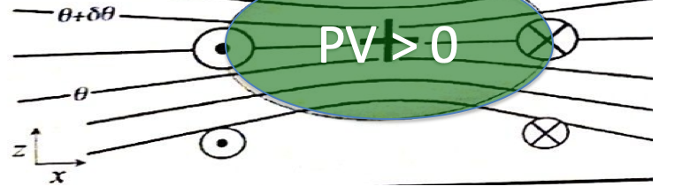
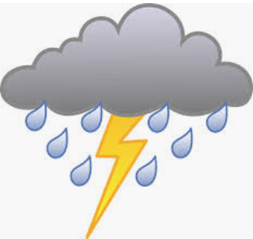

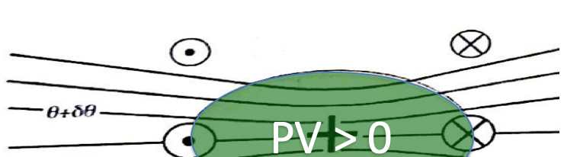
Since our main weather concern is in the lower troposphere (where water is),
This is called a cool core cyclone:
This is called a warm core cyclone:

Slide 22
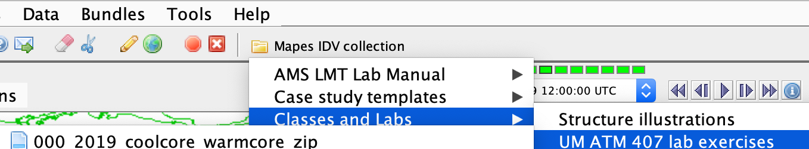
IDV lab assignment -- part 1
Open Mapes IDV → UM ATM407…
0000_coolcore_warmcore…
Explore ALL of its displays, at ALL of its times (loop the animation). Learn to use the IDV. The Help menu has pan-zoom help on top. A mouse is a HUGE help for 3D views.

Slide 23
IDV lab assignment -- part 1
In the following slides, make and label and explain nice clear illustrations like slides 13-17, but for
a warm core anticyclone
a warm core cyclone
a cool core anticyclone

Slide 24
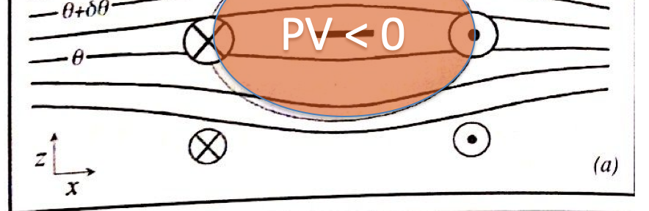
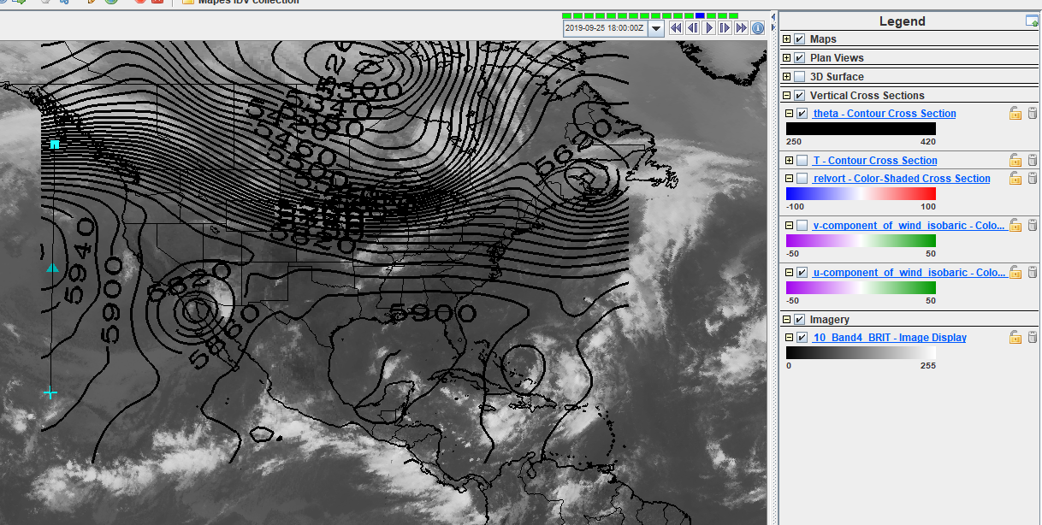
A warm core anticyclone
Western coast of United States (09/25/2019 1800Z). A warm core anticyclone (high pressure system) is better observed in middle/upper levels.

Slide 25
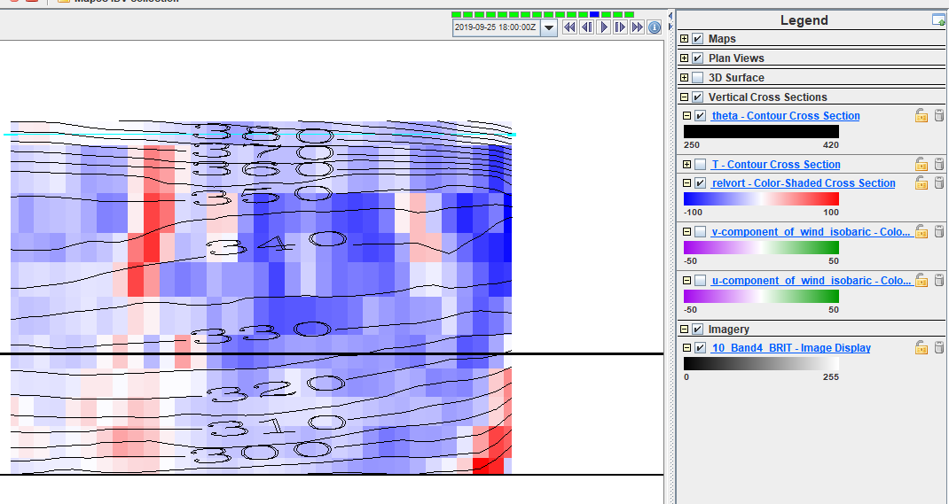
A warm core anticyclone
Negative relative vorticity patch located abode mid level troposphere. In addition, isolines of same potential temperature present a slightly trend to reach lower altitudes when close to negative relative vorticity zone.

Slide 26
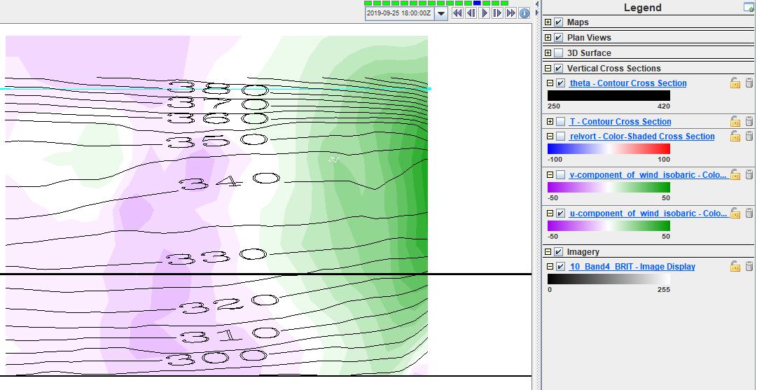
A warm core anticyclone
Inward velocities on the left of the anticyclone and outward velocities on the right. In addition, surface velocities are lower than mid level ones.

Slide 27
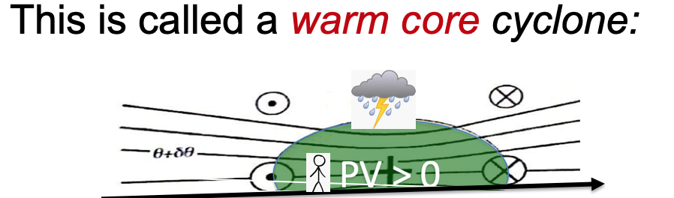
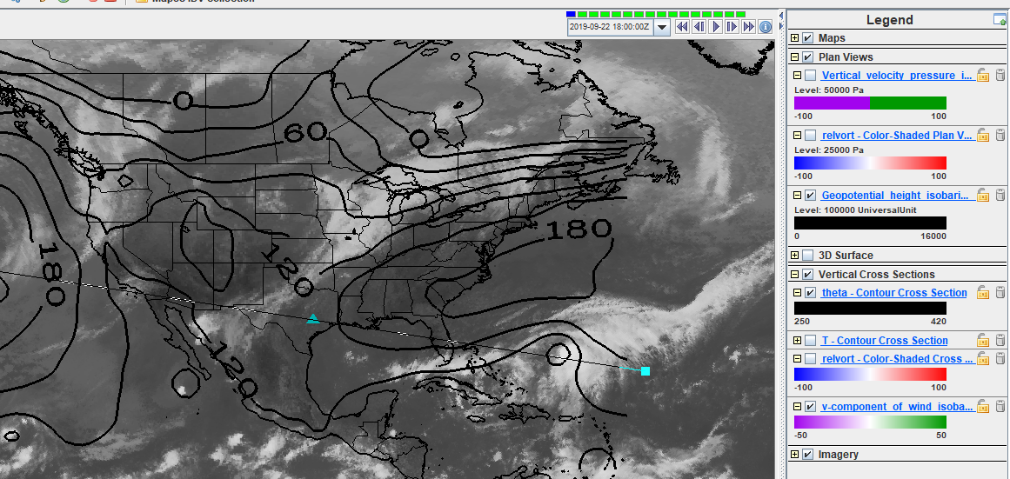
A warm core cyclone
Located northern of Puerto Rico (09/22/2019 – 1800Z), on the Atlantic Ocean, this feature could be called warm core cyclone, because of this well visible low in the lower troposphere, with PV>0 in the middle of the cyclone, Higher wind intensity close to surface and lower intensity winds above.

Slide 28
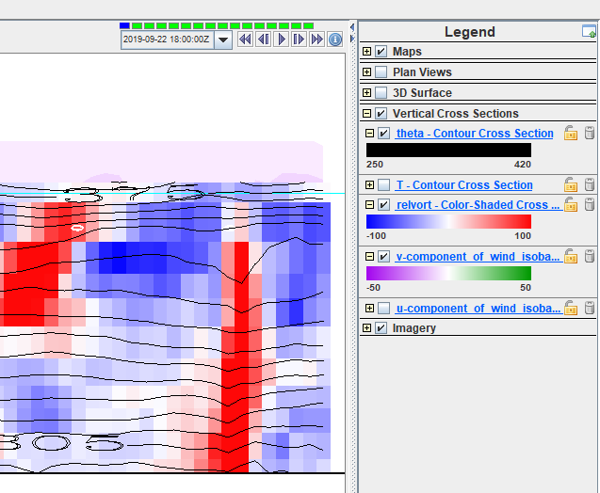
A warm core cyclone
On the cross-section view, it is possible to observe greater PV close to surface. In addition, the lines with same potential temperature reach the lowest height where relative Vorticity >0

Slide 29
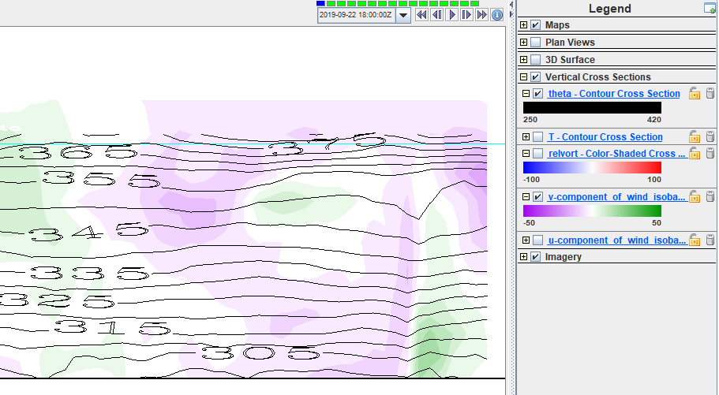
A warm core cyclone
Positive meridional velocities eastern of the cyclone and negative meridional velocities on the west side can be noticed. It is also possible to observe the decrease of wind intensity with height.

Slide 30
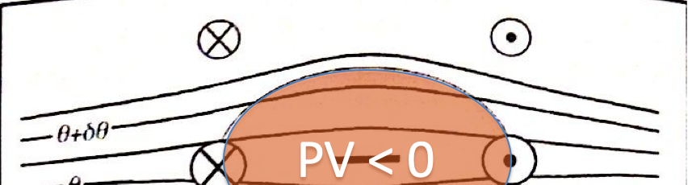
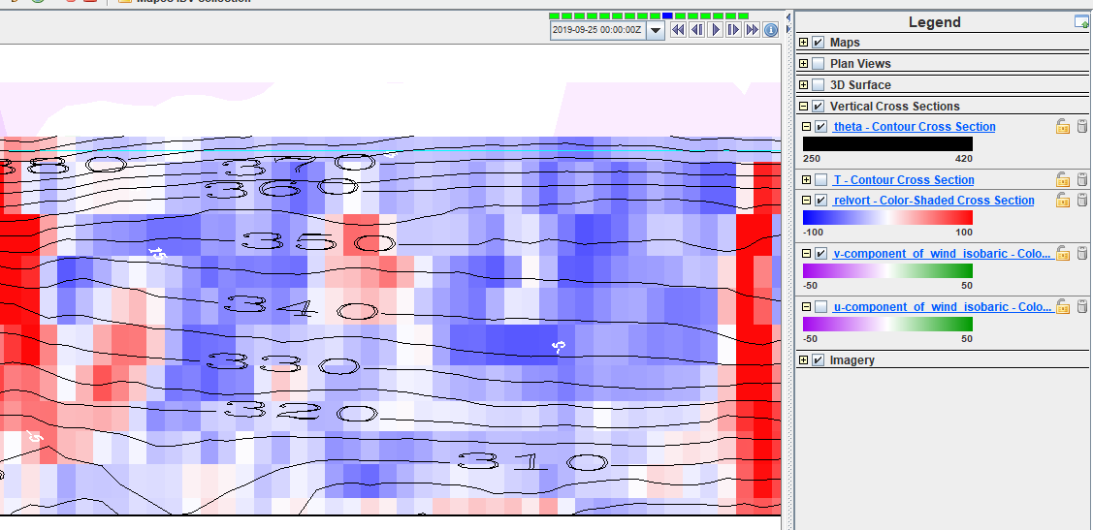
A cool core anticyclone
A cool core anticyclone was located on the coast of Mississippi and Louisiana on 09/25/2019 0000Z. Negative vorticity patch in lower troposphere, with isentrope lines going upward in the center of the anticyclone.

Slide 31
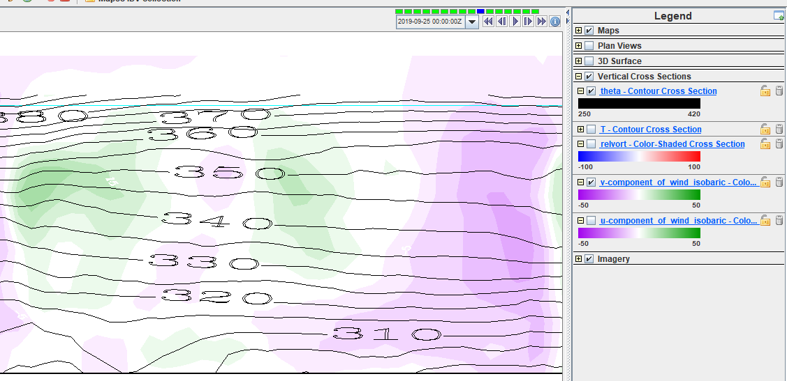
A cool core anticyclone
Equatorward velocities on the east side of the vortex and poleward velocities on the west. Note that the velocity decreases with height, and the vortex is restrained to height where potential temperature >320 K .

Slide 32
Isentropic surfaces
Isentrope contours on the cross sections above are slices of isentropic surfaces
surfaces of constant entropy
or potential temperature, or dry static energy C_{p}T + gz
Let’s learn to see isentropic surfaces
They are almost like material surfaces
because Dθ/Dt = 0 for adiabatic flow
(plus nonadiabatic or “diabatic” complications)
Their vertical motion is air vertical motion!
the holy grail, for clouds+rain (weather)

Slide 33
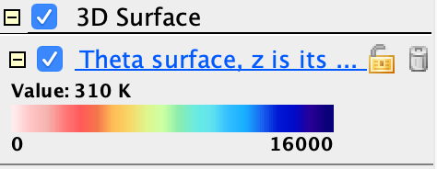

IDV Lab assignment part 2
In the same bundle, activate (check) the display called “Theta surface, z is its color”
Adjust the value (310K, 330K, 360K)
Use vorticity isosurfaces and cross sections in an illustrated description of its topography.
Is there a mean north-south slope? hint:
What vorticity features (Part I) explain dimples?
What vorticity features (Part I) explain peaks?

Slide 34
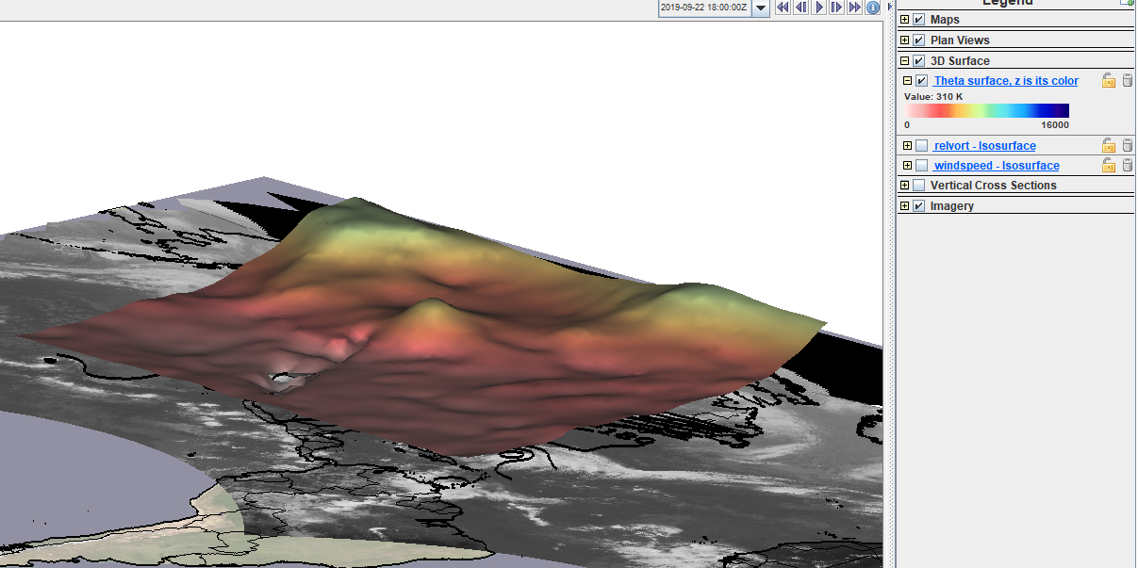
Mean slope of the 310K isosurface

Slide 35
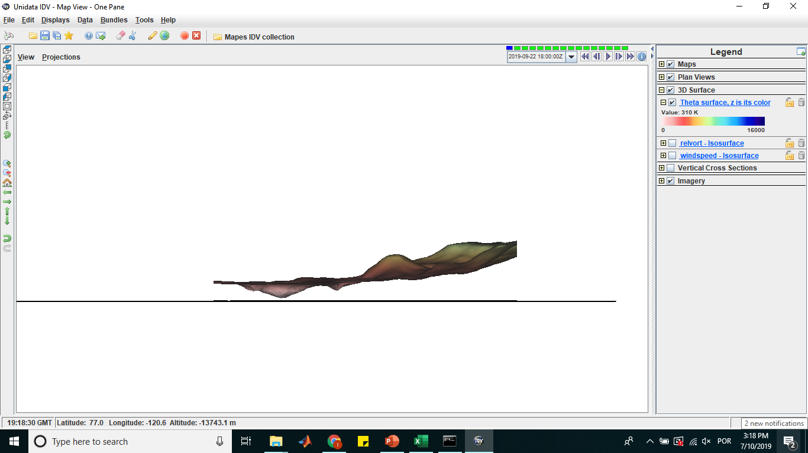

Mean slope of the 310K isosurface
$$\frac{Δz}{Δy}=\frac{Z2−Z1}{y2−y1}=\frac{7000m−2200m}{65°−12°}=\frac{4800m}{43°}=111.62 m/°$$
$$\frac{Δy}{Δx}$$

Slide 36
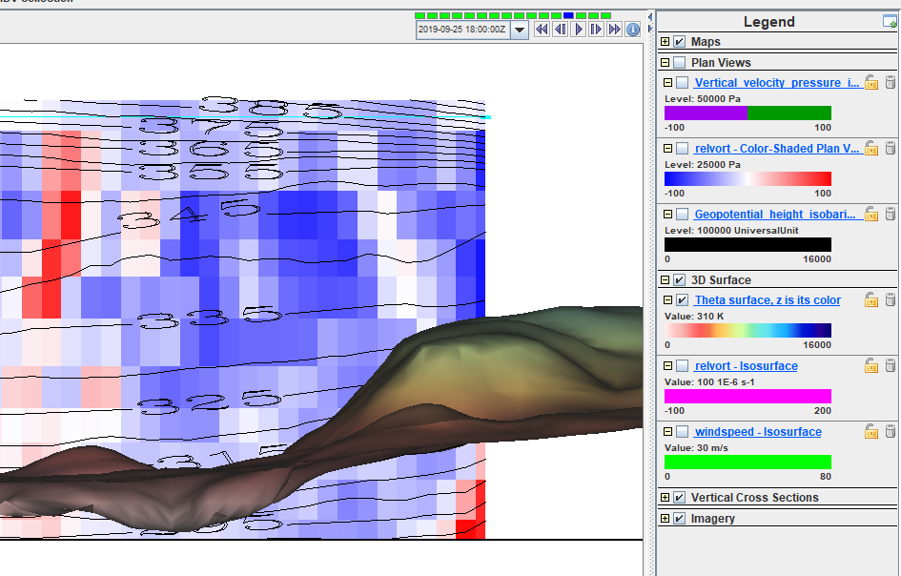
A depression in the 310K surface
In a warm core anticyclone, the 310K isosurface is pushed away from the vortex, because the vortex is located on mid levels.

Slide 37
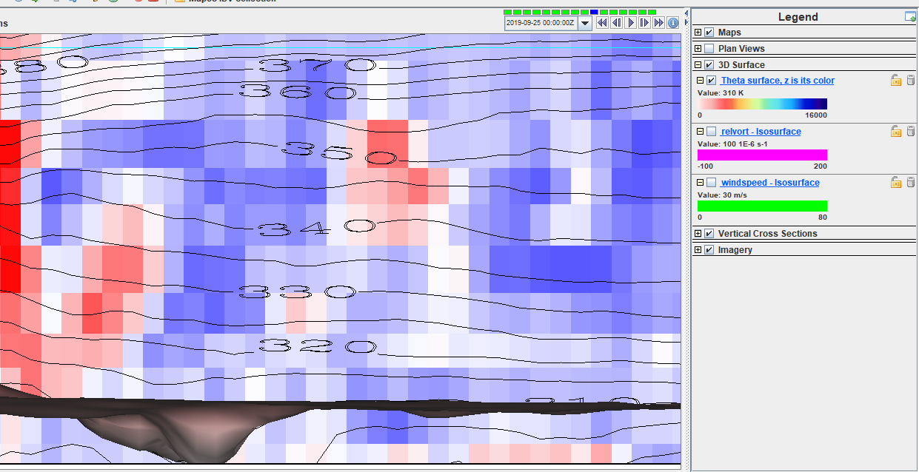
A peak on the 310K isosurface
Cool core anticyclone vortex. This happens with the 310K isosurface, because the vortex is located on the lower levels and it has a trend to push 310 k isentrope line slightly up in the lower levels.

Slide 38
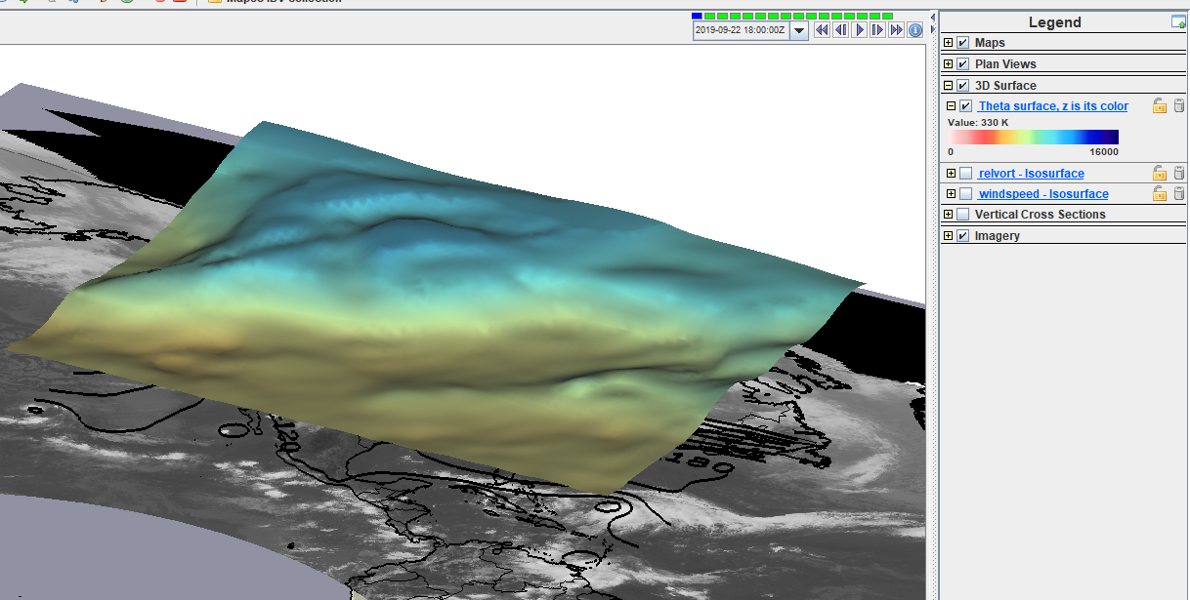
Mean slope of the 330K isosurface

Slide 39
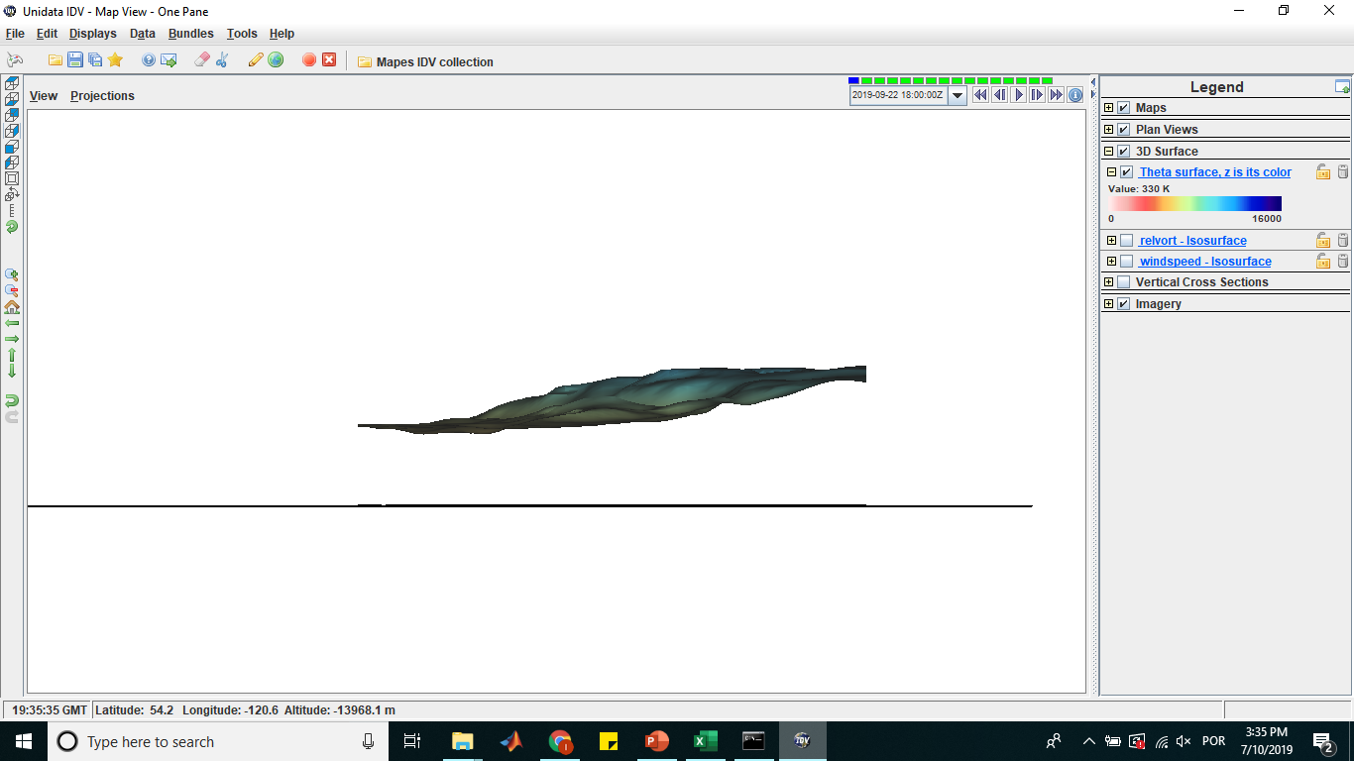
Mean slope of the 330K isosurface
$$\frac{Δz}{Δy}=\frac{Z2−Z1}{y2−y1}=\frac{9500m−6000m}{65°−12°}=\frac{3500m}{43°}=81.39 m/°$$

Slide 40
A depression in the 330K surface
For the vortexes choosed, none of them generated a depression in the 330 K surface or the variation was difficult to observed.

Slide 41
A peak on the 330K isosurface
For the vortexes choosed, none of them generated a peak in the 330 K surface or the variation was difficult to observed.

Slide 42
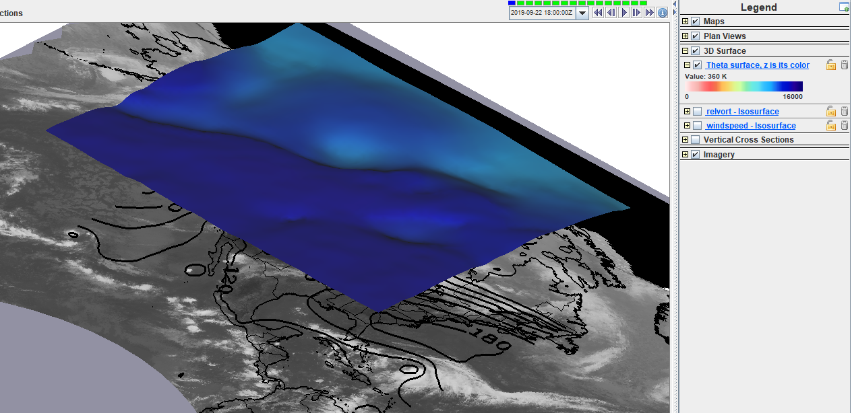
Mean slope of the 360K isosurface

Slide 43
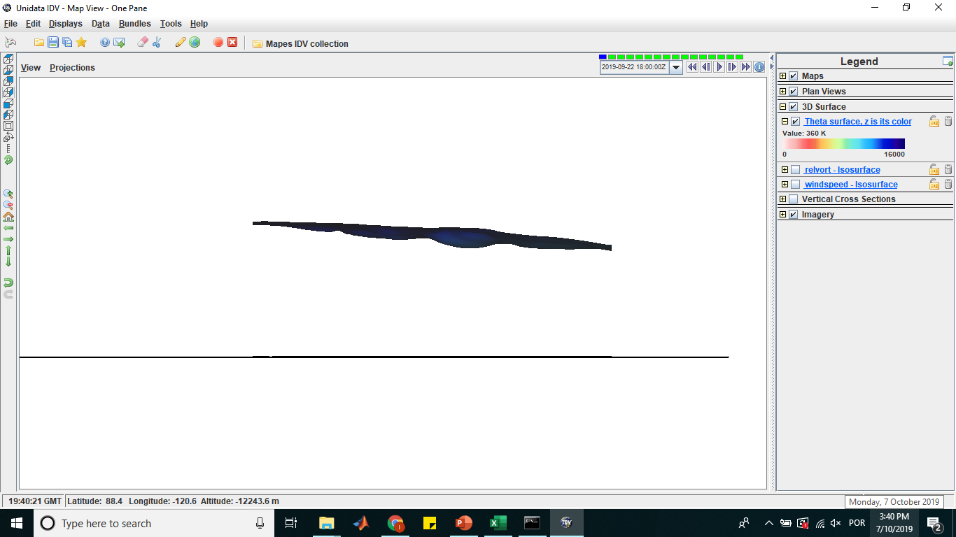
Mean slope of the 360K isosurface
$$\frac{Δz}{Δy}=\frac{Z2−Z1}{y2−y1}=\frac{11500m−14500m}{65°−12°}=\frac{−3000m}{43°}=−69.76 m/°$$

Slide 44
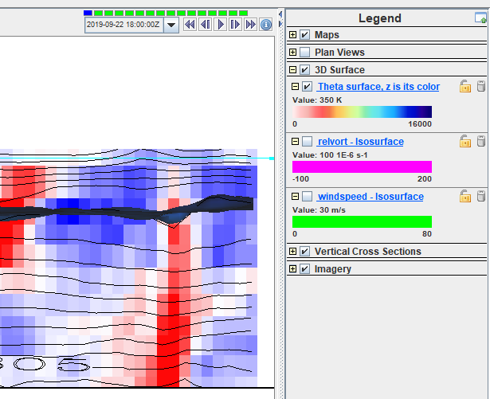
A depression in the 360K surface
For this specific case of warm core cyclone, the cyclone is located underneath the 360K surface. Therefore, the influence of this vortex is not felt on this surface, however, a depression is observed if considered the 350K surface because the warm core vortex tend to pull down the isentrope lines in the upper levels.

Slide 45
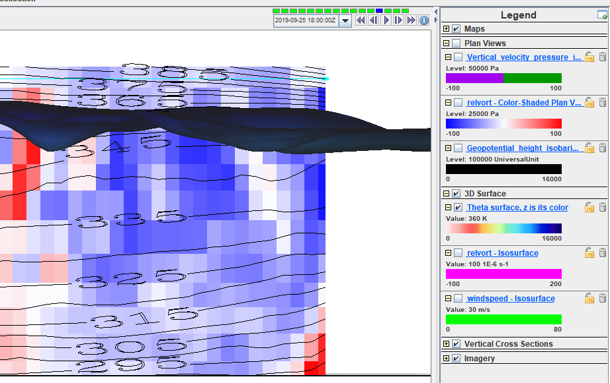
A peak on the 360K isosurface
In a war core cyclone, the cortex would originate a pear on the 360K isosurface because the vortex is located right below this surface and it tends to push the isentrope lines away from the vortex.

Slide 46
Use the Print facility of Powerpoint
to put a PDF of this into your class Github repository
so we can look them over in class

